Slide 1

Разработка Chrome Apps Текущее состояние и перспективы
Павел Чистяков, ТвГУ – TiTConf – Тверь, 2015

Slide 2

Содержание
Что такое Chrome Apps
Инструменты разработки
Основа приложений
Используемые API
Примеры приложений

Slide 3

Chrome Apps?

Slide 4
Виды дополнений
Расширения
Приложения
hosted apps
packaged apps (Chrome Apps)

Slide 5
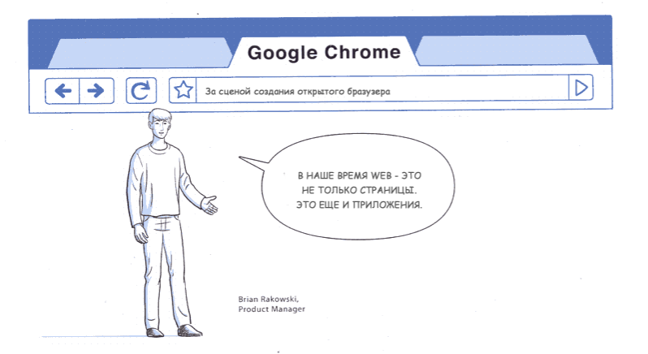

Slide 6
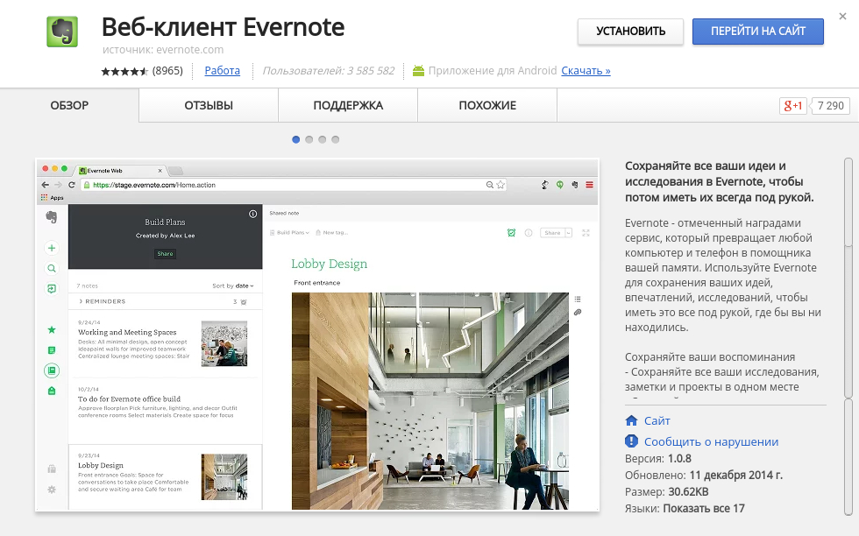
Evernote Hosted App

Slide 7
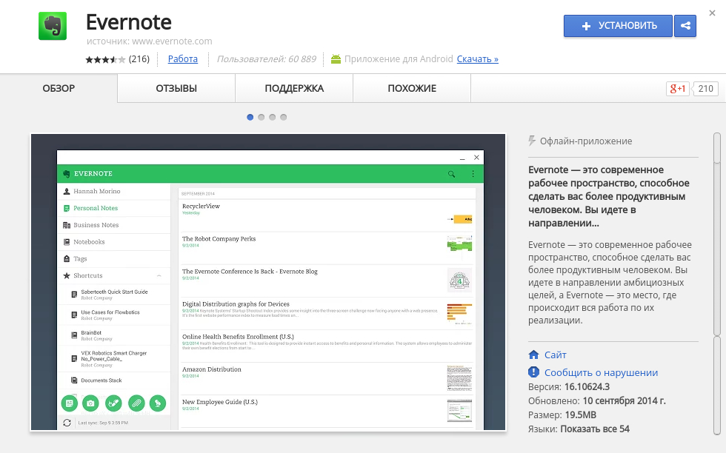
Evernote Chrome App

Slide 8

Инструменты разработки

Slide 9








Привычные редакторы

Slide 10
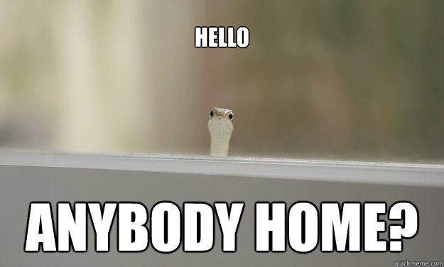
А что может предложить Chrome OS?

Slide 11






Редакторы Chrome OS

Slide 12

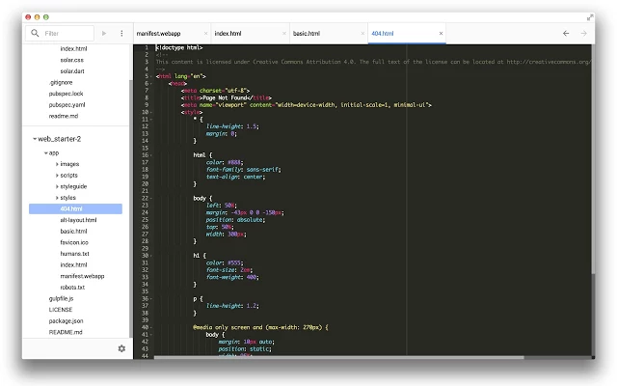
Chrome Dev Editor

Slide 13
Преимущества
Создание разных типов приложений
Частичная поддержка Git
Мобильная отладка (только Android)
Bower, Polymer & Web Starter Kit
Публикация в Chrome Web Store
Нескучные темы оформления :-)

Slide 14

Разработка приложений

Slide 15
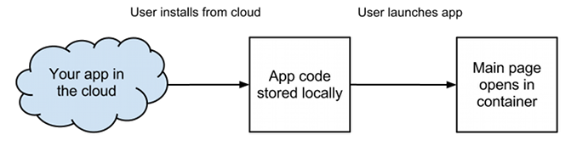
Об архитектуре

Slide 16
Основа приложений
manifest.json
background script
app code
assets

Slide 17
manifest.json
{
// Обязательные
"manifest_version": 2,
"version": "1.3.18",
"name": "App Name",
"app": {
"background": {
// Подключаемые скрипты
"scripts": [ "background.js" ]
}
},
// Рекомендуемые
"default_locale": "en",
"offline_enabled": true,
"description": "App Description",
"icons": { "48": "48.png", "128": "128.png" },
"permissions": [ "background", "power", "notifications" ]
}
➤ https://developer.chrome.com/apps/manifest

Slide 18
background script
chrome.app.runtime.onLaunched.addListener(function() {
chrome.app.window.create('main.html', {
id: 'powerWindow',
bounds: {
width: 400,
height: 600
},
maxWidth: 600
maxHeight: 800,
});
});

Slide 19
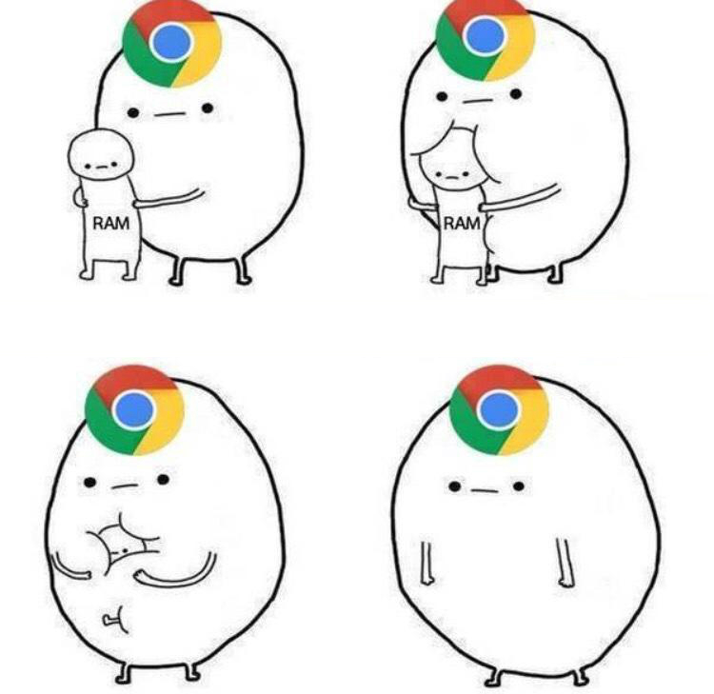

Slide 20
chrome.* APIs
alarms
contextMenus
notifications
gcm
bluetooth
i18n
commands
sockets.*
hid
fileSystem
runtime
identity
mediaGalleries
tts
system.*
fileSystemProvider
usb
storage
power
permissions
serial
syncFileSystem
documentScan
audio
browser
copresence
location
printerProvider
vpnProvider
wallpaper
experimental
stable ➟ beta ➟ dev
➤ https://developer.chrome.com/apps/api_index

Slide 21
Web APIs
XMLHttpRequest
HTML5 APIs
Webkit APIs
Web Animations
Service Worker
Battery Status API
Screen Orientation API
Fetch API
Encrypted Media Extensions
Push API
Web MIDI API
ES6 Features
Permissions API
"First-Party-Only" cookies
Web Audio Features
stable ➟ beta ➟ dev
➤ https://chromestatus.com/features

Slide 22


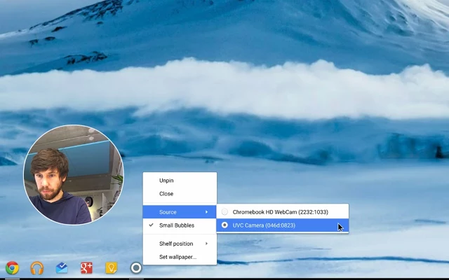
François Beaufort
Have you ever wanted to include your face while recording a screencast session on your Chromebook? If so, let me introduce you to the Bubble Mirror Chrome App for Chrome OS Dev Channel.
When launched, your webcam video feed will be displayed in a tiny always on top bubble window that can be moved around the screen. If the bubble is too small, change it in the App Launcher context menu. And last, but not least, if you've plugged in multiple Webcams, you can also choose the Video Source from there.
Hopefully Bubble Mirror will be a handy companion to Hangouts On Air, Screencastify and TechSmith Snagit. And as usual, source code (<100 lines) is publicly available on GitHub.

Slide 23
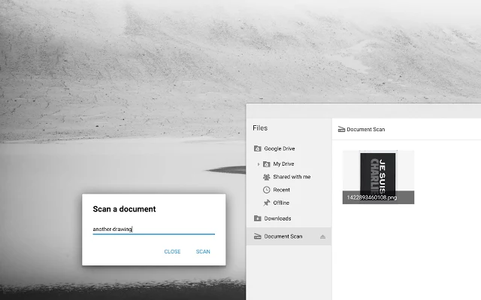
François Beaufort
Lorgnette the young service to handle document scanner in Chrome OS is available in Dev Channel. That means we can now play with it through the Document Scan Chrome API. So here it is! A tiny Chrome App to scan your paper documents directly from your Chrome Device.
In this sample, you'll notice that all your scanned documents are available in a new "Document Scan" section of the Files App thanks to the fileSystemProvider chrome API. Check out the source code in the GitHub Repository and see how nicely Polymer Paper Elements fit together in the app.
Be aware that only SANE-compatible Scanners will work out of the box for now since Lorgnette relies on the open-source project SANE. Therefore make sure your document scanner is in the list before.

Slide 24
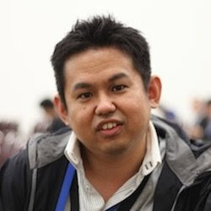
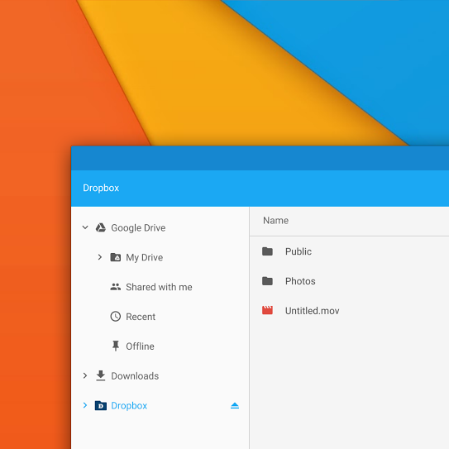
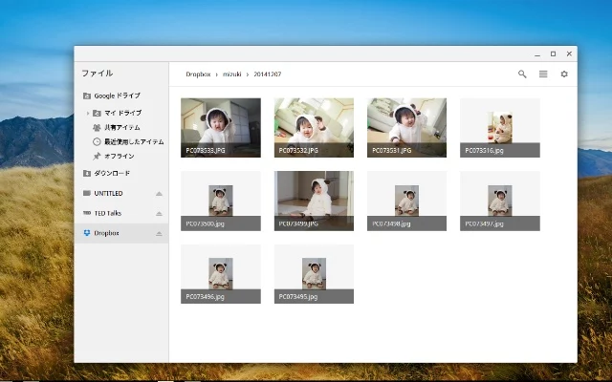
Yoichiro Tanaka
I have just released a new File System Provider implementation for Dropbox! You can mount your Dropbox directories/files to your Chromebook filesystem, and can access each directory/file from the File apps and many Chrome apps. If you have Chromebook, install and try this application soon!

Slide 25
Что в разработке?
WebGL 2 ⬈
Streams API ⬈
SVG2 ⬈
Web Bluetooth ⬈
Dart VM ⬈
MediaRecorder ⬈
Background Sync API ⬈
Ambient Light Events ⬈
Network Information API ⬈
chrome.printerProvider ⬈
Device Orientation API ⬈
Credential Management API ⬈
В приложения и Chrome UI внедряют Material Design
Добавляют поддержку игровых движков на HTML5

Slide 26
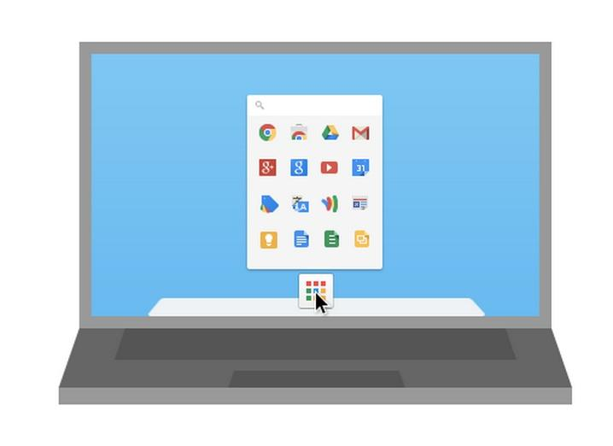
Преимущества

Slide 27
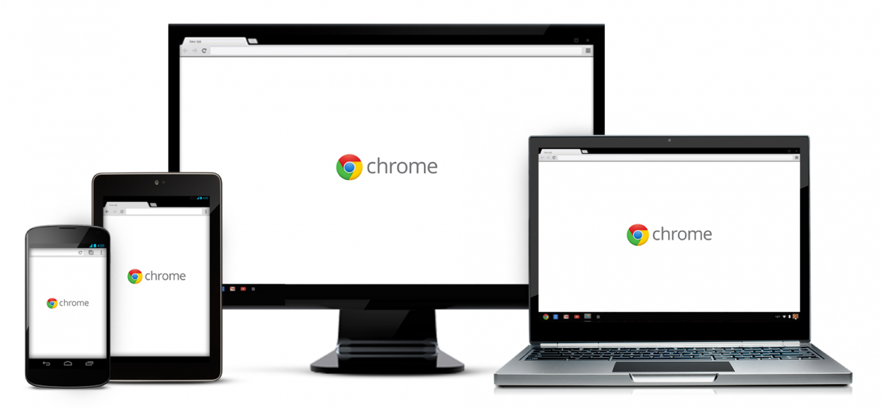
Преимущества
Кроссплатформенность

Slide 28
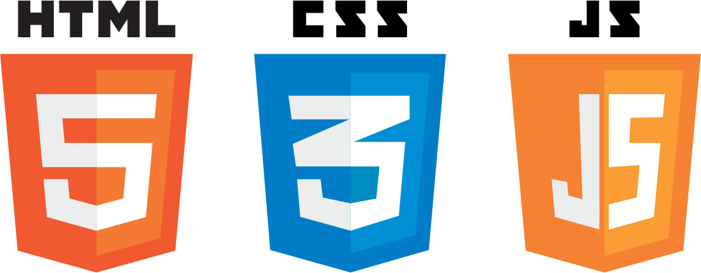
Преимущества
Привычные технологии

Slide 29
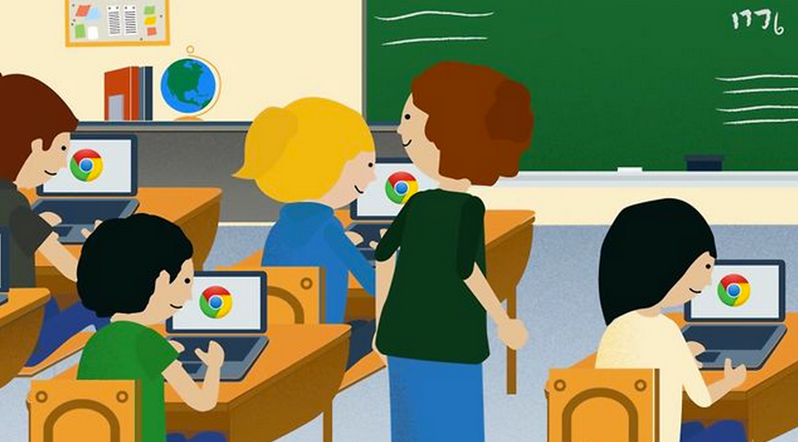
Преимущества
Огромный рынок

Slide 30




Вопросы?
@web_xaser
+ПавелЧистяков611
@web_xaser
http://www.web-xaser.ru

